Slide 1

FoodLoop AI
Artificial Intelligence Closing the Food Waste Loop
Hackathon 2025

Slide 2
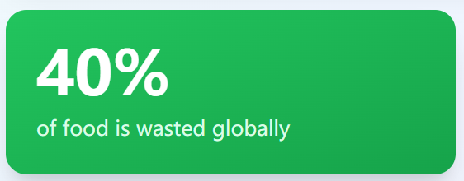
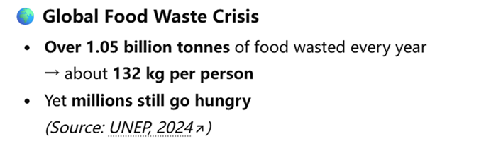
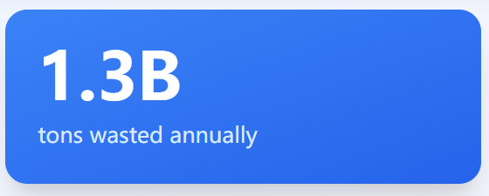
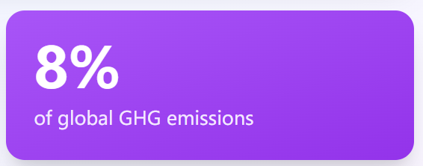
Paradoxical food crisis
https://news.un.org/en/story/2024/03/1148036

Slide 3
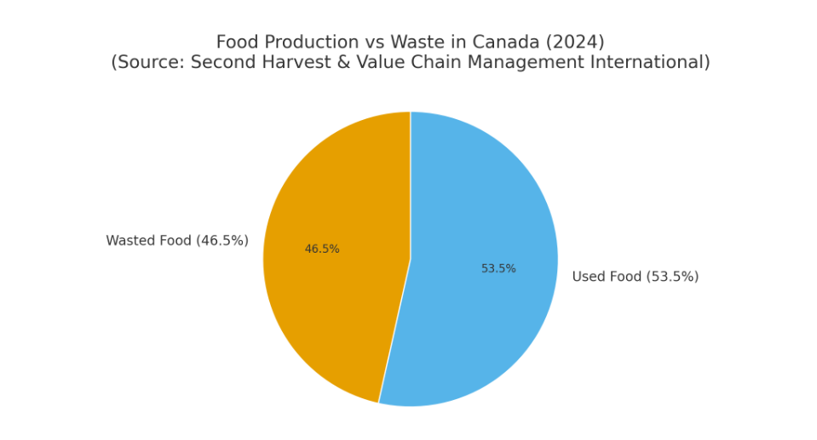
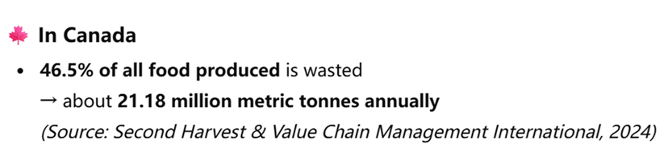
Situation in Canada

Slide 4



Our Solution: FoodLoop AI
Trust Through Intelligence
Ecosystem Connection
AI-Based Verification
Real-Time Sharing
Unites donors, NGOs, and shelters on a single, streamlined platform.
Builds trust and transparency through intelligent supplier analysis.
Enables instant matching and smart notifications for time-sensitive donations.

Slide 5
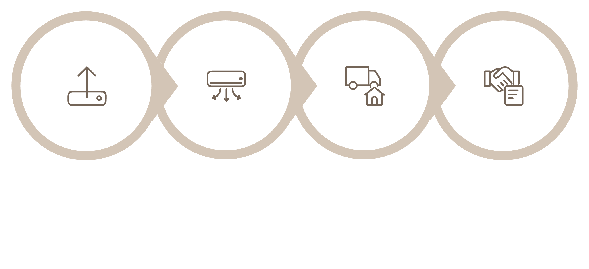



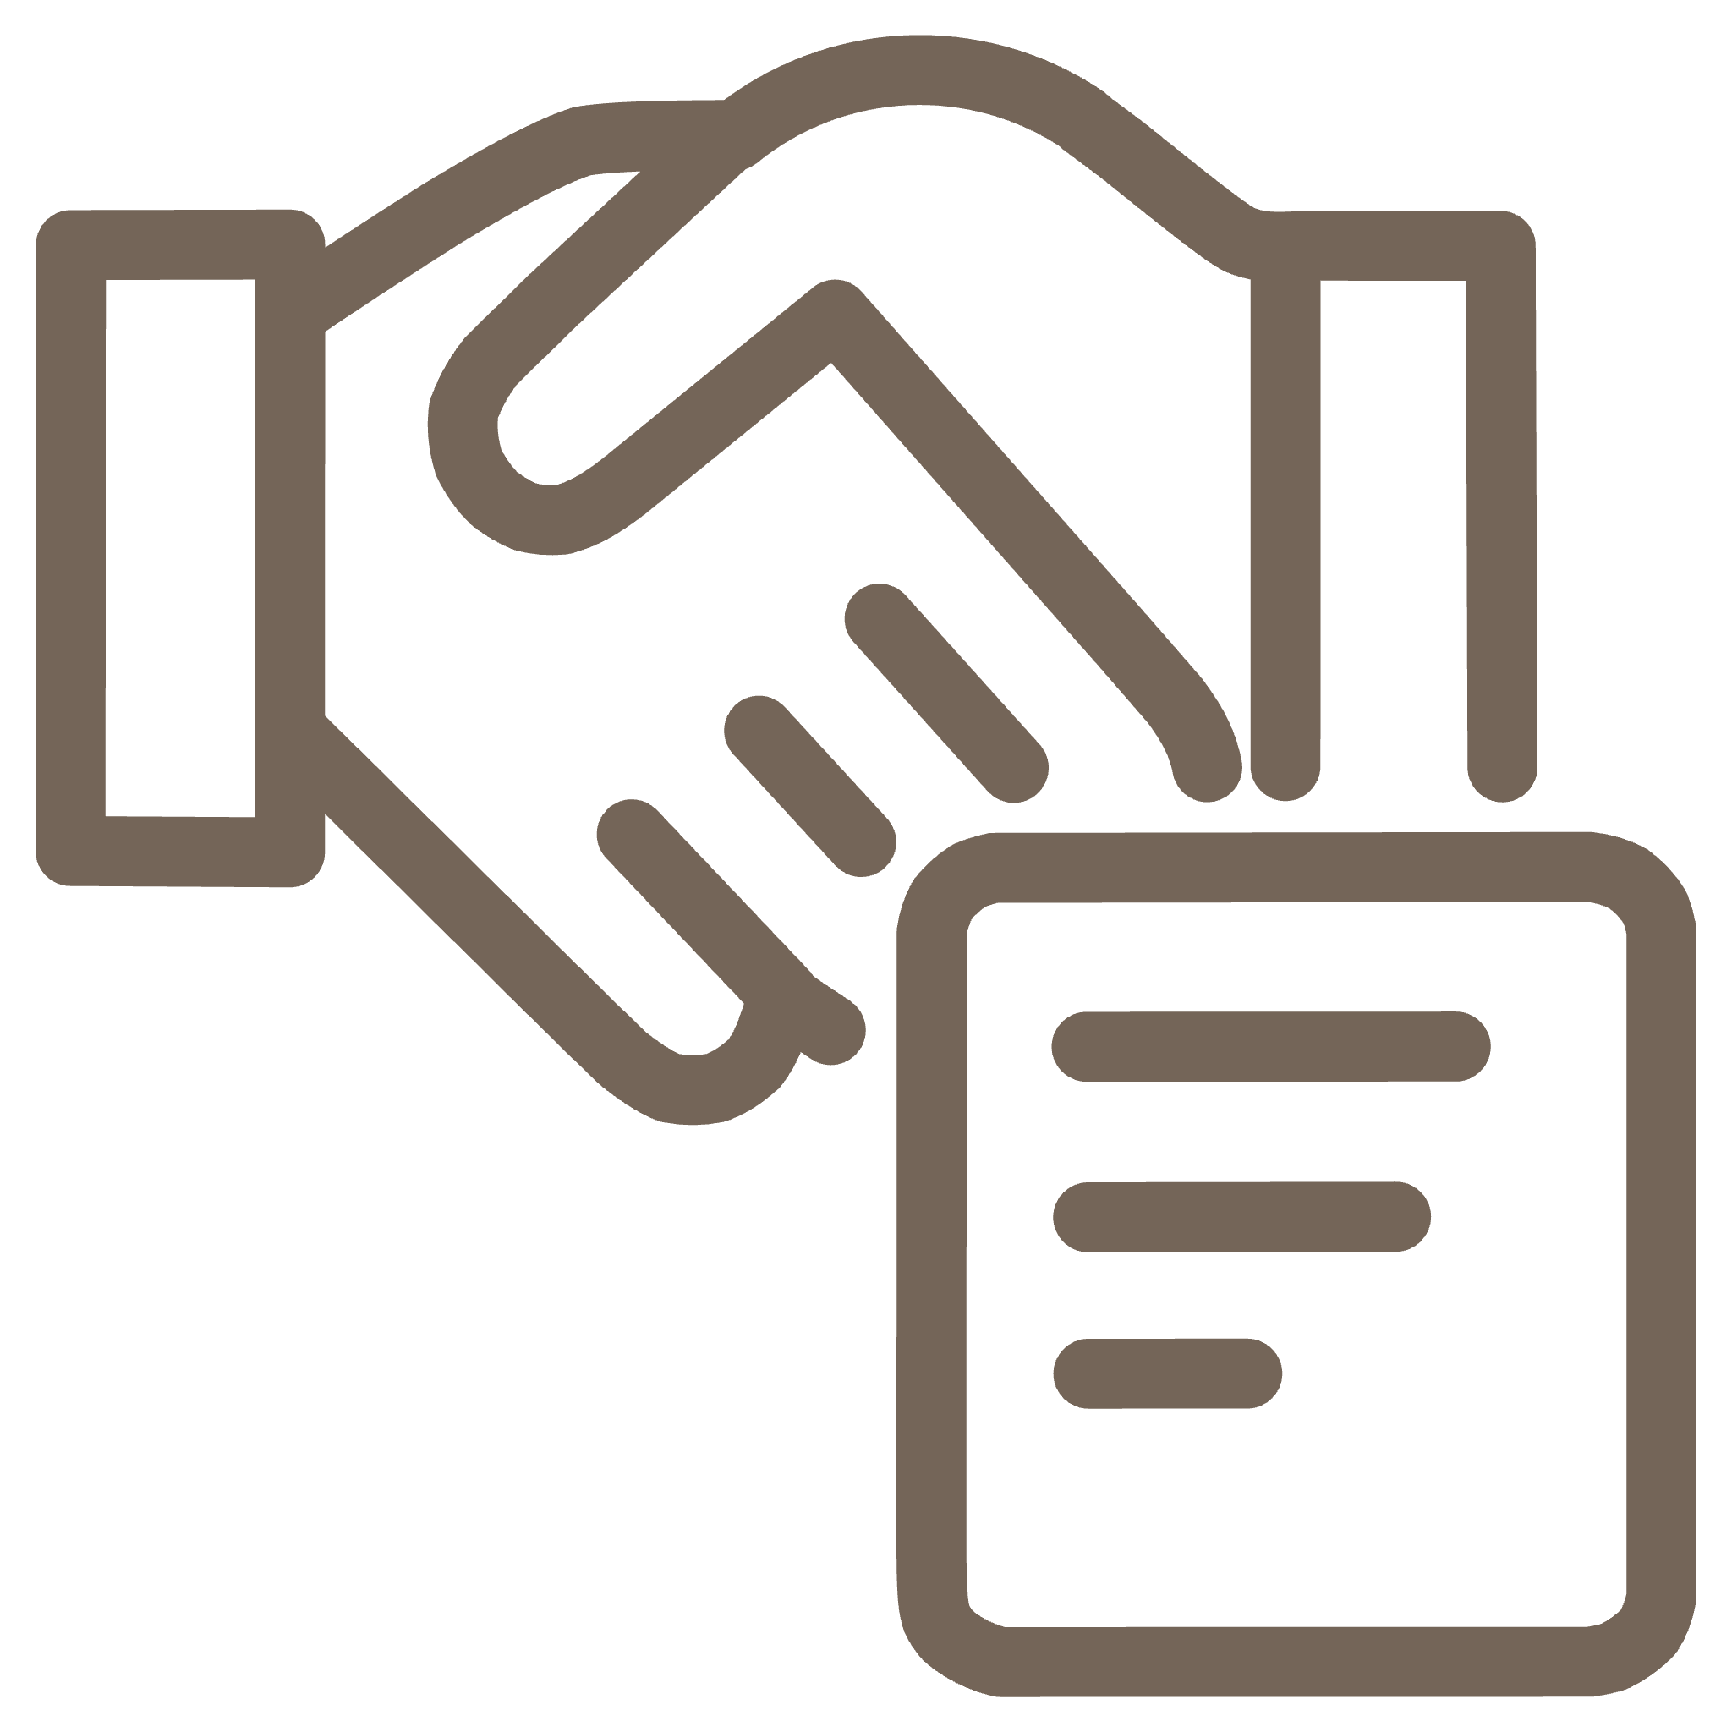
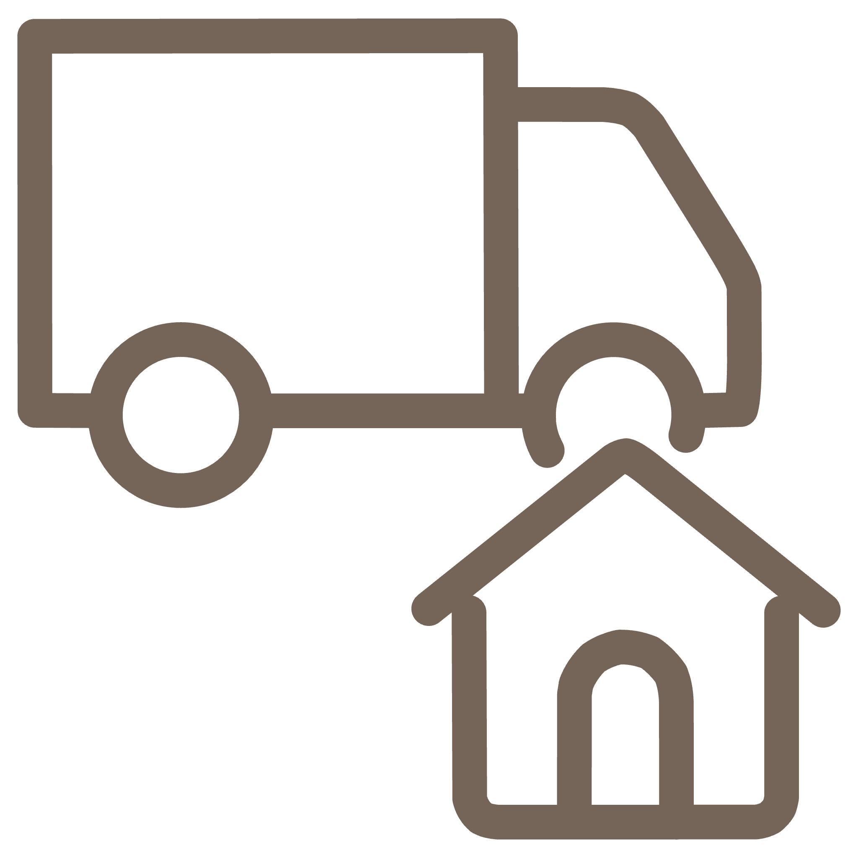
The FoodLoop AI Process
Supplier Uploads
AI Analyzes
Food Posted
Donation/Transaction
The core innovation is the AI Trust Analysis, which generates a reliability score for every supplier.

Slide 6

Deep Dive: AI Trust Analyzer
The AI ensures reliability by checking multiple data points against local safety standards.
Scrapes Public Data: Reviews, website presence, and social sentiment.
Verifies Certifications: Checks for compliance with food safety standards (e.g., Nova Scotia key certifications).
Generates Trust Score: Provides NGOs with a verifiable, actionable reliability rating (out of 5).

Slide 7




Key Features Driving Efficiency
Smart Matching
Image + Expiry Detection
Connects donors and NGOs automatically based on need and proximity.
Ensures visual transparency and monitors product freshness.
Event Posting System
Instant Notifications
NGOs can proactively request specific food items for upcoming events.
Keeps all stakeholders updated in real-time for rapid claiming and pickup.

Slide 8
Measurable Impact
80% Reduction in Research Time
Significantly Reduced Waste
NGOs instantly access verified donor data, eliminating manual checks.
Surplus food moves faster from donor to recipient, minimizing spoilage.
Trust and Accountability
Circular Food System
A verifiable system builds strong, reliable relationships between partners.
Promotes sustainability where surplus meets community nourishment.

Slide 9

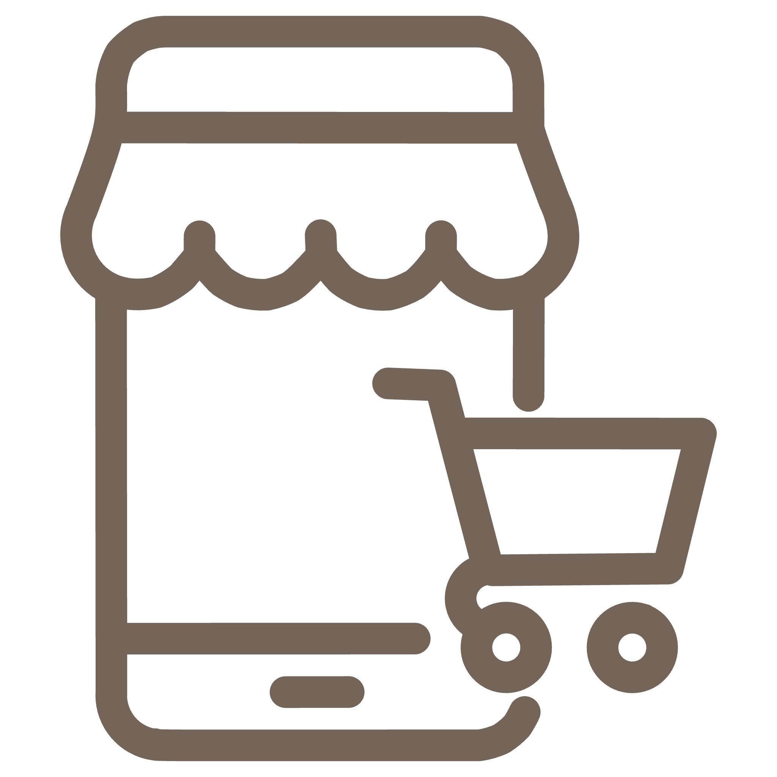


Future Scope & Expansion
Image Freshness Detection
Mobile-First Adoption
Integrate computer vision for objective, visual verification of food quality.
Launch dedicated mobile app for real-time updates and seamless location-based pickups.
Strategic Partnerships
Donor Reward System
Collaborate with local municipalities and food safety boards for broader adoption.
Introduce incentives to encourage consistent and high-quality donations.

Slide 10
Stakeholders & Benefits
SUPPLY SLIDE -> DEMAND SIDE -> LOGISTIC PROVIDERS ->GOVERNMENT
Opportunity Visibility
Visualize Opportunities: discover exchange or donation opportunities.
Empower Suppliers: maximize profit through smarter visibility, matching, and logistics optimization.
Maximize Demand-side Options: give the demand side greater access to diverse, timely, and affordable options.
Create Logistics Opportunities: engage logistics providers in a shared, data-driven delivery network to enhance efficiency and reduce waste.
Risk Predictability
Incorporate an alerting system based on data analysis that notifies suppliers in advance about Potential surplus trends and Expiration
Government Statistics
The Food loop platform offers a one-stop solution for accessing government statistics related to food donations and waste disposal trends.

Slide 11

Our Vision for the Future
To build an AI-driven ecosystem that ensures no good food goes to waste—and every community gets the nourishment it deserves.
Team FullLoop AI
Let’s close the loop on food waste together 🌍💚

